Slide 1
Digital-to-Analog
Analog-to-Digital

Slide 2
Data Handling Systems
Both data about the physical world and control signals sent to interact with the physical world are typically "analog" or continuously varying quantities.
In order to use the power of digital electronics, one must convert from analog to digital form on the experimental measurement end and convert from digital to analog form on the control or output end of a laboratory system.

Slide 3
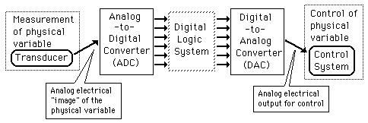
Data Collection and Control

Slide 4
Digital-to-Analog Conversion [DAC]

Slide 5
Digital-to-Analog Conversion
When data is in binary form, the 0's and 1's may be of several forms such as the TTL form where the logic zero may be a value up to 0.8 volts and the 1 may be a voltage from 2 to 5 volts.
The data can be converted to clean digital form using gates which are designed to be on or off depending on the value of the incoming signal.

Slide 6
Digital-to-Analog Conversion
Data in clean binary digital form can be converted to an analog form by using a summing amplifier.
For example, a simple 4-bit D/A converter can be made with a four-input summing amplifier.

Slide 7
Digital-to-Analog Conversion
2 Basic Approaches
  Weighted Summing Amplifier
  R-2R Network Approach

Slide 8
Weighted Sum DAC
One way to achieve D/A conversion is to use a summing amplifier.
This approach is not satisfactory for a large number of bits because it requires too much precision in the summing resistors.
This problem is overcome in the R-2R network DAC.

Slide 9
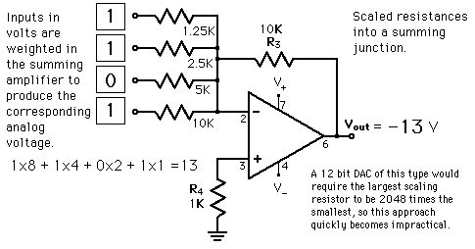
Weighted Sum DAC

Slide 10
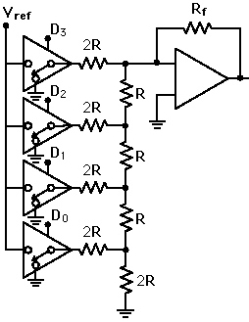

R-2R Ladder DAC

Slide 11
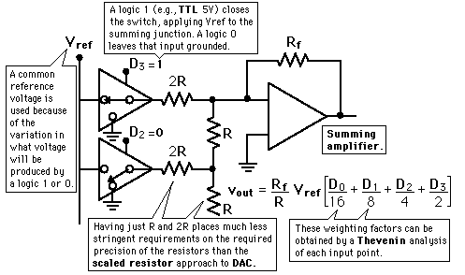
R-2R Ladder DAC

Slide 12
R-2R Ladder DAC
The summing amplifier with the R-2R ladder of resistances shown produces the output where the D's take the value 0 or 1.
The digital inputs could be TTL voltages which close the switches on a logical 1 and leave it grounded for a logical 0.
This is illustrated for 4 bits, but can be extended to any number with just the resistance values R and 2R.

Slide 13
Analog to Digital Conversion [ADC]

Slide 14
ADC Basic Principle
The basic principle of operation is to use the comparator principle to determine whether or not to turn on a particular bit of the binary number output.
It is typical for an ADC to use a digital-to-analog converter (DAC) to determine one of the inputs to the comparator.

Slide 15
ADC Various Approaches
3 Basic Types
Digital-Ramp ADC
Successive Approximation ADC
Flash ADC

Slide 16
Digital-Ramp ADC
Conversion from analog to digital form inherently involves comparator action where the value of the analog voltage at some point in time is compared with some standard.
A common way to do that is to apply the analog voltage to one terminal of a comparator and trigger a binary counter which drives a DAC.

Slide 17
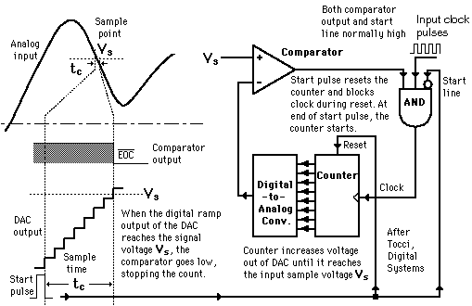
Digital-Ramp ADC

Slide 18
Digital-Ramp ADC
The output of the DAC is applied to the other terminal of the comparator.
Since the output of the DAC is increasing with the counter, it will trigger the comparator at some point when its voltage exceeds the analog input.
The transition of the comparator stops the binary counter, which at that point holds the digital value corresponding to the analog voltage.

Slide 19
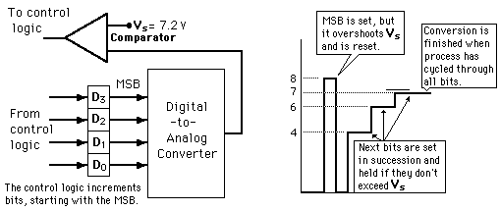
Successive approximation ADC
Illustration of 4-bit SAC with 1 volt step size

Slide 20
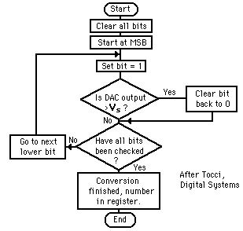
Successive approximation ADC
Much faster than the digital ramp ADC because it uses digital logic to converge on the value closest to the input voltage.
A comparator and a DAC are used in the process.

Slide 21
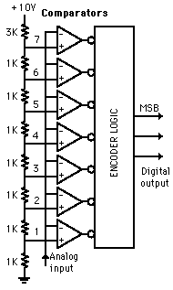
Flash ADC
It is the fastest type of ADC available, but requires a comparator for each value of output.
(63 for 6-bit, 255 for 8-bit, etc.)
Such ADCs are available in IC form up to 8-bit and 10-bit flash ADCs (1023 comparators) are planned.
The encoder logic executes a truth table to convert the ladder of inputs to the binary number output.
Illustrated is a 3-bit flash ADC with resolution 1 volt

Slide 22
Flash ADC
The resistor net and comparators provide an input to the combinational logic circuit, so the conversion time is just the propagation delay through the network - it is not limited by the clock rate or some convergence sequence.

